Slide 1

^{Music Recommendation system} ^{using Content Filtering}
^{M.Sabeer Faisal}

Slide 2
Introduction and background knowledge
Importance of music recommendation systems
Existing challenges in collaborative filtering
Content filtering as a popular approach
Need for content-based recommendation systems
Contributions of the study
Overview of related works

Slide 3
Importance of music recommendation systems
Vast amount of music poses as challenge for users
Music recommendation systems play suggest personalized song recommendations to users.
enhance user experiences
boost user retention on music streaming platforms.

Slide 4
Existing challenges in collaborative filtering
Collaborative filtering is a commonly used. But it also aces certain challenges:
"Cold Start"
"Sparsity"

Slide 5
Content filtering as a popular approach:
Popular alternative approach
Recommends new songs based on the content features of songs
Overcomes the limitations of collaborative filtering by leveraging the inherent characteristics of the items themselves.

Slide 6
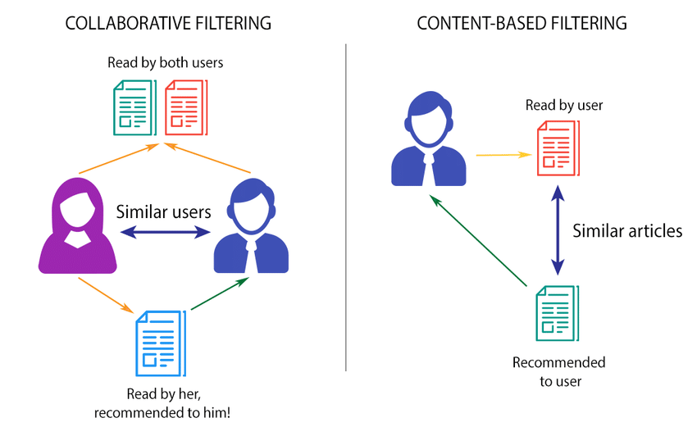
Comparison
This figure shows comparison between collaborative and content filtering.
This picture is taken frrom ResearchGate

Slide 7
Contributions of the study:
Develop and evaluate a music recommendation system using content filtering.
Provides insights into the effectiveness of content-based approaches and their potential for improving music recommendation systems.
Content features:
Lyrics
Chords
Genre

Slide 8
Methodology
Description of the dataset from Ultimate Guitar
Importance of lyrics, chords, and genre information
Preprocessing steps: handling null values, text cleaning, tokenization, stemming
Vectorization using TF-IDF construction
Neural network model using Keras
Training and optimization details
Testing and recommendation process

Slide 9
dataset from Ultimate Guitar
Sample Dataset:

Slide 10
Importance of lyrics, chords, and genre information
Lyrics have a valuable insight into the content and themes of a song
Chords provide information about the musical structure and key of a song. Used to group songs of similar harmonics.
Genre information provides a high-level categorization of the music

Slide 11
Preprocessing steps
Removal of Null values.
Text cleaning using.
Tokenization of words.
Stemming of words.

Slide 12
Vectorization using TF-IDF
Term Frequency-Inverse Document Frequency (TF-IDF) was used to convert text into numerical input.
TF-IDF assigns weights to each word based on its frequency in the lyrics and overall relevancy of the sons in the dataset

Slide 13
Construction of the neural network model using Keras
Keras is a high-level deep learning framework that simplifies the process of building and training neural network models.
A neural network model was constructed using Keras, consisting of several layers of densely connected nodes.
The model takes in the vectorized lyrics and chords as input and generates a recommendation score for each song in the dataset.

Slide 14
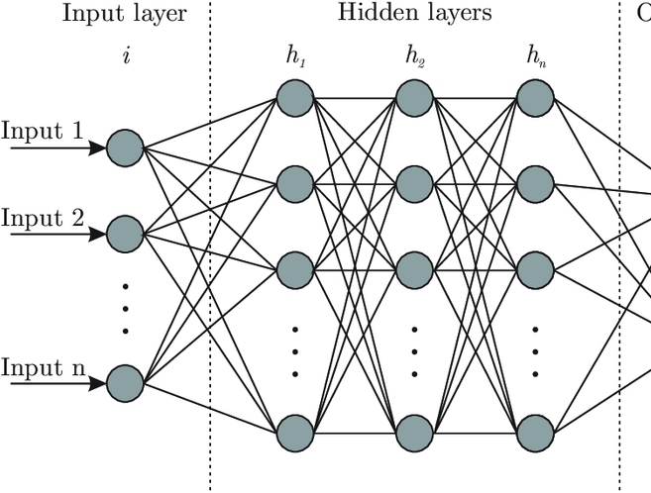
Neural Network Architecture
This is an example of an architecture of neural network.

Slide 15
Training and optimization
Trained using a part off the dataset leaving the rest for training.
The model was optimized using a combination of hyperparameter tuning and cross-validation techniques to maximize its accuracy and minimize overfitting.

Slide 16
Testing and recommendation process
Trained using a part off the dataset leaving the rest for training.
The model was optimized using a combination of hyperparameter tuning and cross-validation techniques to maximize its accuracy and minimize overfitting.

Slide 17
Results
Evaluation of the music recommendation system: Achieved accuracy (75%)
Influence of lyrics on accuracy: discussing the importance of lyrics as features
Effectiveness of text preprocessing techniques: how they affect accuracy
Coverage of research questions: discussing how the system answers research questions

Slide 18
Evaluation of the music recommendation system:
The achieved accuracy of the system was 75%, indicating that it correctly recommended songs that aligned with user preferences in 75% of the cases.

Slide 19
Influence of lyrics on accuracy
The inclusion of lyrics as features in the recommendation system significantly contributed to the accuracy of the recommendations.
Lyrics provide valuable semantic information about the songs, allowing the system to capture the thematic and emotional aspects that influence user preferences.

Slide 20
Effectiveness of text preprocessing techniques
Text preprocessing techniques, such as handling null values, text cleaning, tokenization, and stemming, played a crucial role in improving the accuracy of the recommendation system.
By eliminating noise, reducing dimensionality, and standardizing the text data, the preprocessing techniques enhanced the system's ability to extract meaningful patterns and make accurate recommendations.

Slide 21
Coverage of research questions
The music recommendation system addressed several research questions, such as the impact of lyrics, chords, and genre information on the recommendation accuracy.
The system provided insights into the effectiveness of different approaches, such as collaborative filtering and content-based filtering, in the context of music recommendations.
It also explored the influence of text preprocessing techniques on the system's performance and the potential for improving genre consistency in recommendations.

Slide 22
Sample Results
INDEX | SONG TITLE | CHORDS | GENRE
1805 | COLD LITTLE HEART | Eb Gm Eb Cm Eb Gm Eb Cm Gm Fadd9 Cm F Gm Fadd9 | RNB
844 | FAVOURITE RECORD | Bm G D A Bm G D A Bm G D A Bm G D A | HIPHOP
1127 | VIDEO GAMES | C G F Em C C G F Em Em C Ebaug Em | POP
1911 | SOMEONE NEW | G Bm C D (slide)Em D Bm C G Bm C D (slide) Em | RNB
2069 | TURNING TABLES | Em7 C Em C Em7 C Em C | RNB
1637 | BACK TO DECEMBER | Dsus4 D Bm G Dsus4 D Bm G | POP
2399 | OCEANS WHERE FEET MAY FAIL | Bm A D A Em Bm A D A Em Bm G D A Bm G D A | ROCK
1425 | WRECKING BALL | Bm D A G Bm D A G Bm D A G Bm D A G | POP
1970 | CLOWN | G Cmaj7 Am G D G Cmaj7 Am G D | RNB
1015 | ROLLING IN THE DEEP | Am G F F G (G) Am G F F G | POP
These are the results after using ‘Wagon Wheel’ as an input to the the trained model

Slide 23
Discussion
Interpretation of the results: discussing the findings of the study
Potential improvements for accuracy: presenting possible ways to improve the system
Importance of considering lyrics in recommendations: highlighting the significance of lyrics in music similarity
Consideration of tempo for genre consistency: discussing how tempo affects genre and music similarity
Significance of text preprocessing techniques: discussing the importance of text preprocessing techniques in music recommendation systems
Future directions for research: presenting possible research directions based on the findings

Slide 24
Interpretation of the results
The study's findings indicate that the music recommendation system achieved a decent accuracy of 75% in recommending new songs to users.
The inclusion of lyrics as a content feature greatly influenced the accuracy of the system, allowing it to capture the essence of songs and provide more accurate recommendations.
The evaluation of the system's accuracy was based on comparing recommended songs with ground truth genre labels from the dataset.

Slide 25
Potential Improvements for Accuracy
Enhancing the system by incorporating additional features such as artist information and user preferences could lead to improved accuracy.
Exploring advanced machine learning techniques, such as deep learning models, may help capture more complex relationships between songs and improve recommendation performance.

Slide 26
Importance of considering lyrics in recommendations
The study emphasizes the significance of lyrics as a crucial feature in music similarity and highlights the need to incorporate them in music recommendation systems.
Lyrics contribute to the system's ability to recommend songs with similar themes and preserve the mood consistency between songs.

Slide 27
Significance of text preprocessing techniques
The study highlights the importance of text preprocessing techniques, such as stemming and removing stopwords, in improving the accuracy of music recommendation systems.
Stemming reduces the variation in word forms and helps capture the root meaning, while removing stopwords eliminates irrelevant words that can hinder the generation of meaningful vector representations.

Slide 28
Consideration of tempo for genre consistency
The study discusses the impact of tempo on genre consistency and music similarity.
By considering tempo, the system can ensure that recommended songs maintain a consistent genre and align with the desired mood or atmosphere.

Slide 29
Future directions for research
Investigating the integration of deep learning models to further enhance the performance and accuracy of music recommendation systems.
Incorporating user feedback and interactions to personalize recommendations and improve the system's adaptability.
Exploring the impact of additional features, such as user listening history and social network data, on the effectiveness of music recommendation systems.
Analyzing the user satisfaction and engagement levels with the recommended songs to evaluate the overall effectiveness of the system.

Slide 30
Conclusion
Importance of lyrics and text preprocessing:
Lyrics capture song essence and improve recommendation accuracy.
Text preprocessing enhances lyrics' meaningfulness for better recommendations.
Summary of contributions:
Evaluated a music recommendation system using lyrics and chords, achieving 75% accuracy.
Demonstrated the effectiveness of content filtering and the importance of lyrics in recommendations.
Recommendations for future research:
Explore advanced machine learning techniques for improved accuracy.
Incorporate additional features and user preferences for personalized recommendations.
Investigate the impact of tempo on genre consistency and music similarity.
Analyze user feedback and engagement metrics for system enhancement.

